Slide 1


InstaHyre Job Analytics
Rahul Bisht (pd16_304)
Shreya Soni (pd18_081)
Sidhartha Agasti (pd19_044)
Piyush Pratap Singh (pd19_073)

Slide 2



Problem Statement
The job market in India is constantly evolving, with new trends emerging and old ones fading away. The project aims to provide a comprehensive overview of the job market in India, using data-driven analysis to identify the key trends and patterns that are driving the market. By understanding these trends, job seekers, employers, and policymakers can make informed decisions about their career paths, hiring strategies, and workforce development initiatives. Through this project, we hope to shed light on the current state of the job market in India, as well as provide insights into how it is likely to evolve in the future. Ultimately, our goal is to help individuals and organizations make better, more informed decisions that will enable them to thrive in an ever-changing job market.

Slide 3
Objective :
Our project is to analyze the job trend in India like skill is in most demand, state having highest no of opening , & many more useful insight
Our Machine-powered system analyzes the company required skill sets and to generate recommendations like no of job opening, level of experience required, size of company which hire more & many more. This saves time and effort for the job seeker.

Slide 4
Strategy
Data Cleaning and modelling
GUI Creation
Python : NumPy , pandas
Python : Streamlit
Web Scraping
Data Visualization and Analyses
Python : Selenium , Beautiful soup, Pandas
Model Creation
Python: Sklearn , pandas, NumPy, nltk
Power bi , Excel

Slide 5
Preprocessing
STEMMING
NORMALIZE
LEMMATISATION
VECTORIZATION

Slide 6
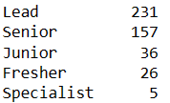
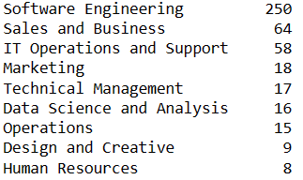
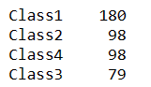
About the Model
1
Most common Experience Level
Model : RandomForestClassifier
Accuracy Score : 57%
2
Most common Department
Model : RandomForestClassifier
Accuracy Score : 88%
3
Most common Company class
Model : Logistic Regression
Accuracy Score : 60%

Slide 7
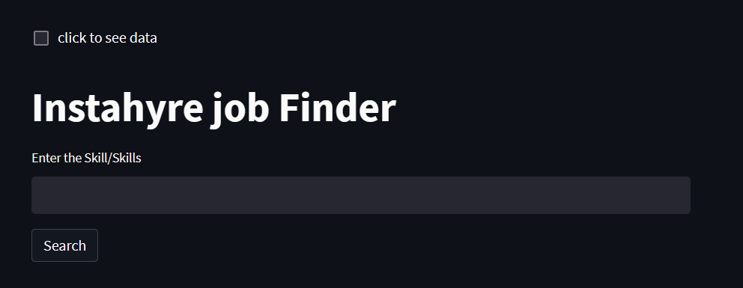
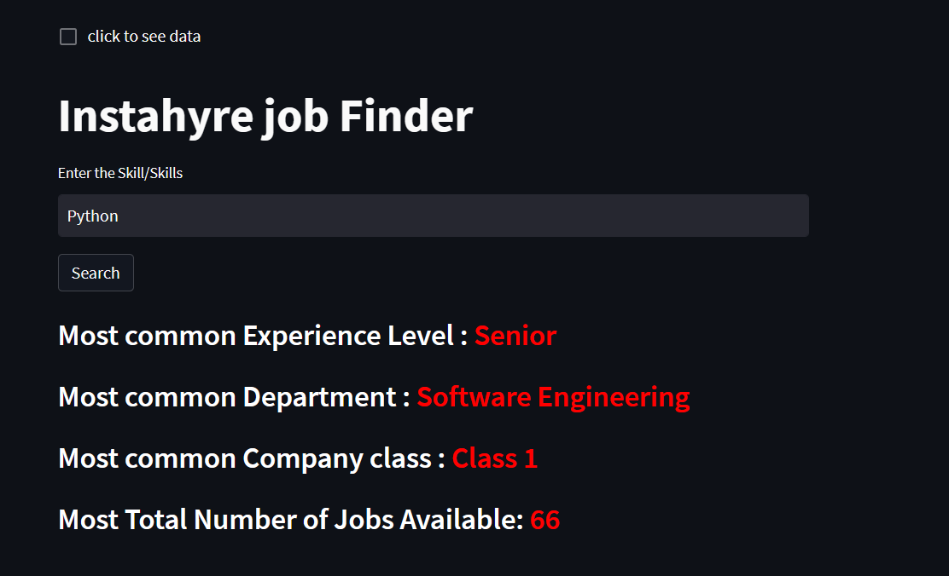
Machine Learning Model Graphical Interface
Revolutionizing the Job Search:
A Machine Powered System for Career
Recommendations Based on Skill Set

Slide 8

Problem Encounter
Non-technical | Technical
Coordination issue: Not discuss about the problem in the starting directly jump into the technical part | Model Building Issue: Need to learn how to deal with the text data Explore the NLTK Library
Time issue: Some of us are working some of them are not, not all of them are free at the same time | Model Deployment Issue: Get to know about the different ways to deploy the model Explore about the streamlit library

Slide 9
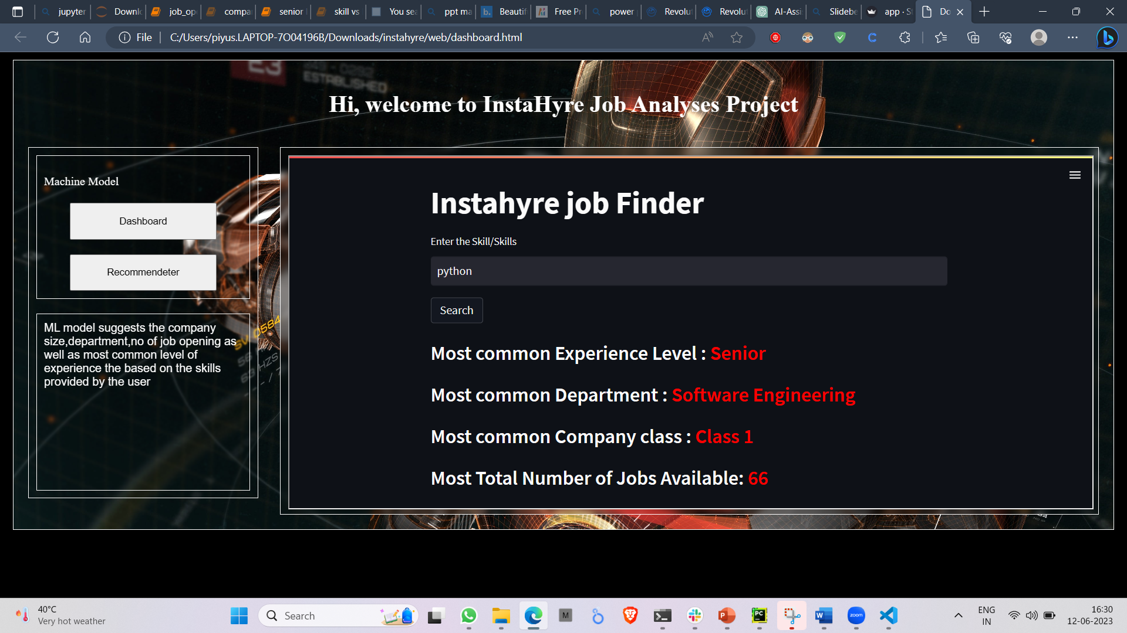
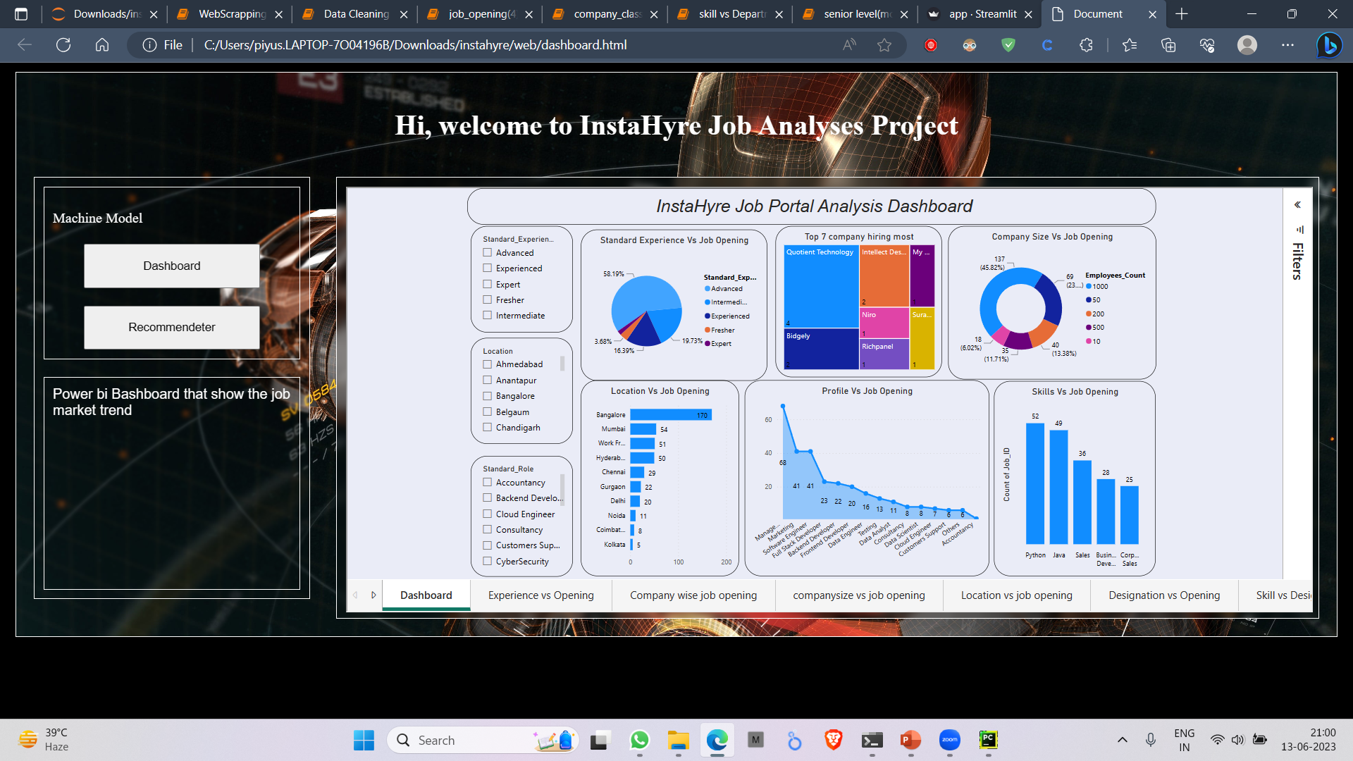
Future Scope
Increase the Accuracy Level
Deploy it into the web server
Enhance the GUI

Slide 10


Learning Outcome
Collaboration and teamwork
Project management
Diversity and inclusivity
Learn new tools
Presentation and communication skills

Slide 11




Thank you

